Slide 1
Groups or multicellular individuals?
If there is almost no heterogeneity within groups, it’s not unrealistic to think of a group as an individual. Like when:
Group is founded by a single ancestor
Drift makes groups homogeneous (needs enough time + not strong selection against cooperators)
Population is structured (like a biofilm or kefir) specifically when it is growing!
Notes:
If there is no heterogeneity within groups we can think of them as individuals. Cases like when 1- groups are founded by a single ancestor 2- there is enough time for drift + no strong selection 3- growing structured populations (like kefir/tumor)

Slide 2
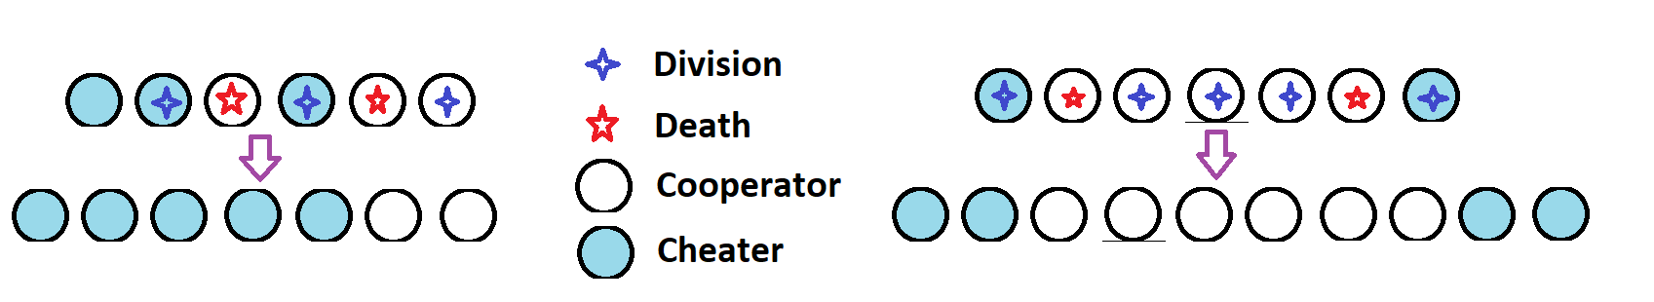
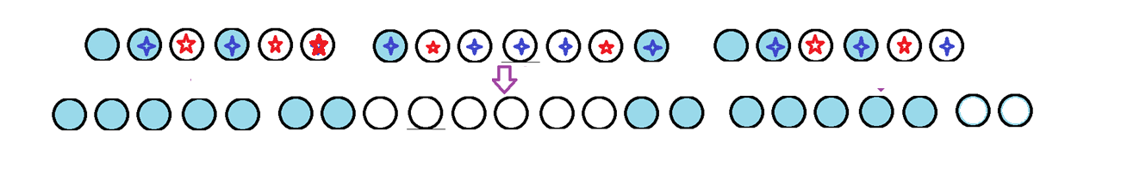
Formation of uniform patches in a growing structured population

Slide 3
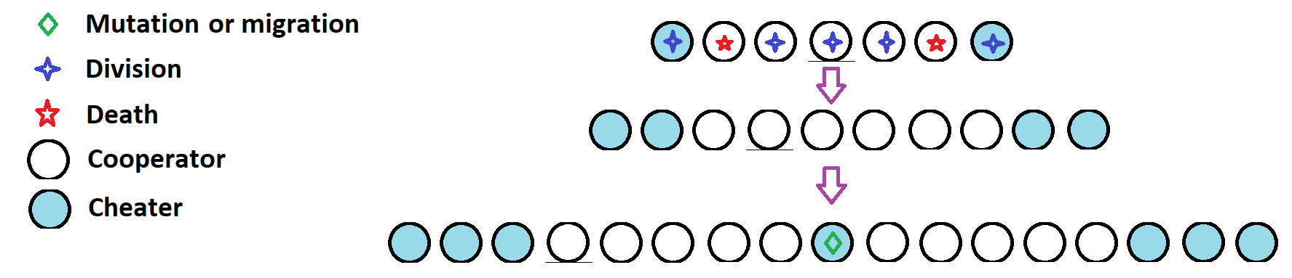
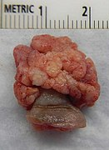
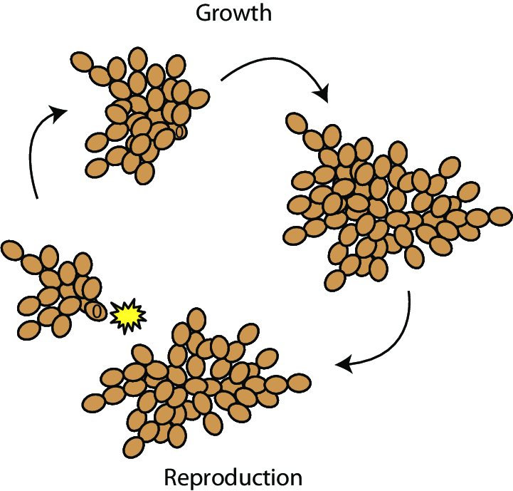
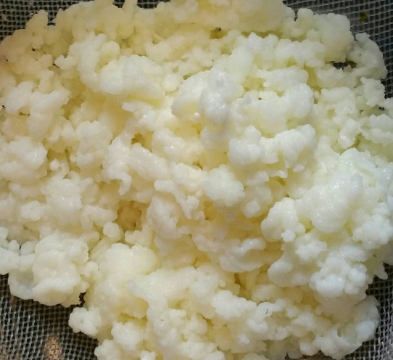
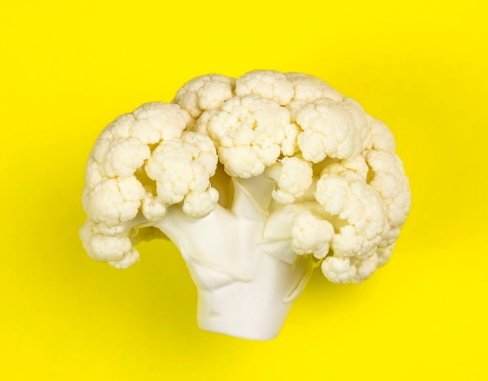
Growth + Mutation = Cauliflower

Slide 4
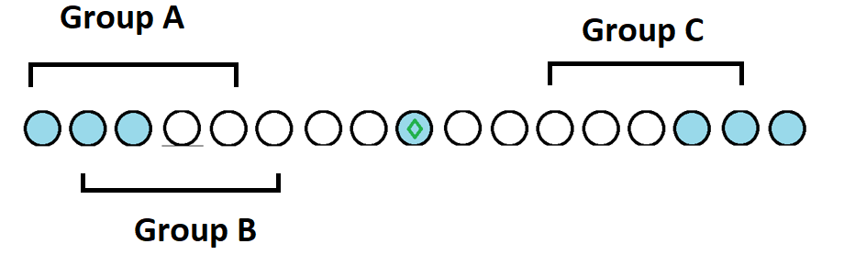
I wanted to make a model to explain the dynamics but how can I define a group when there is no actual group?

Slide 5
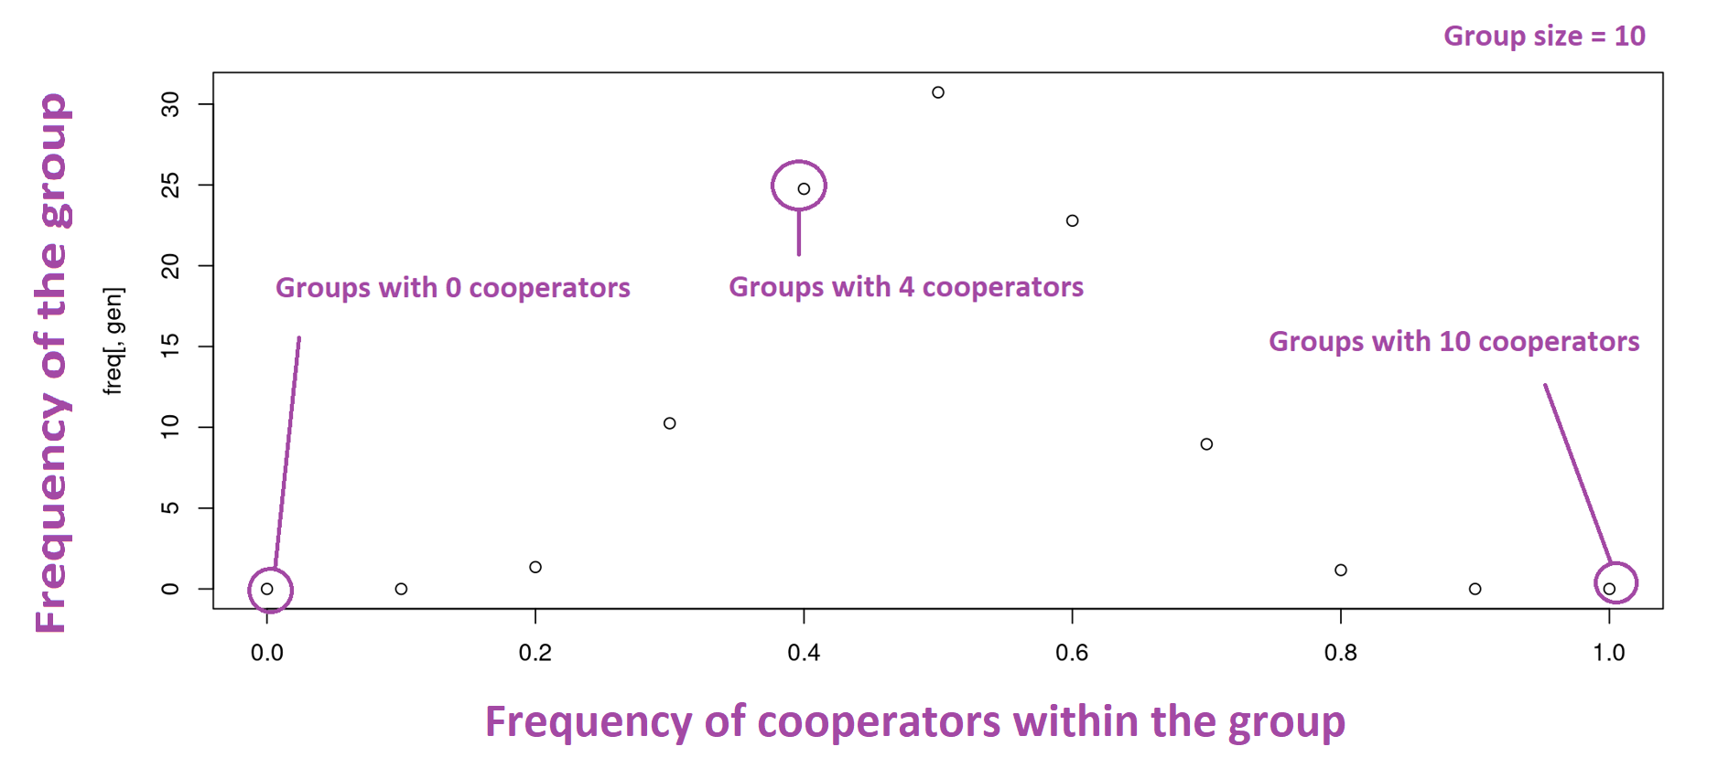
Kefir patch model

Slide 6
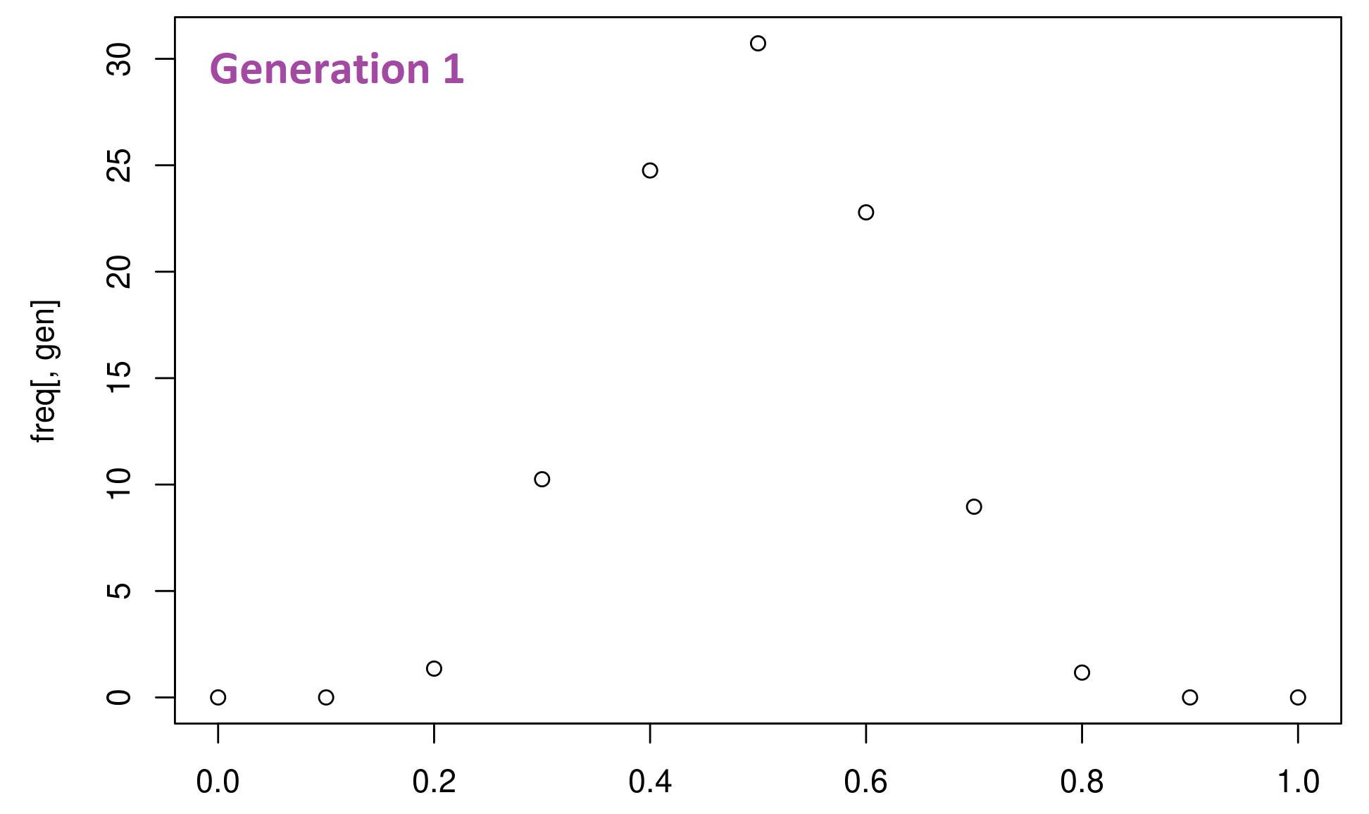
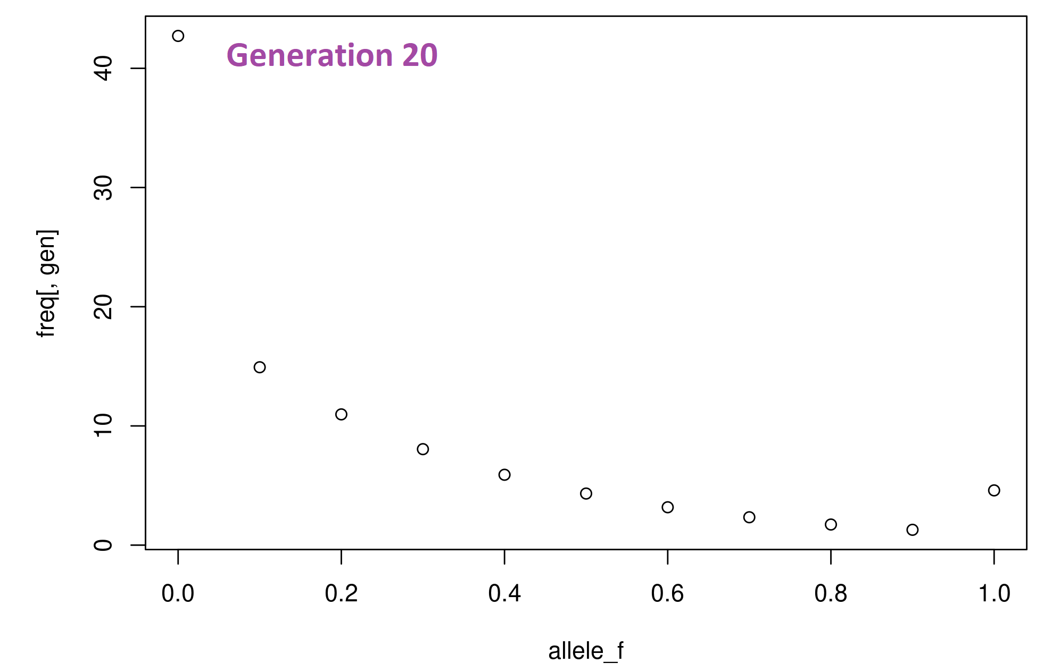
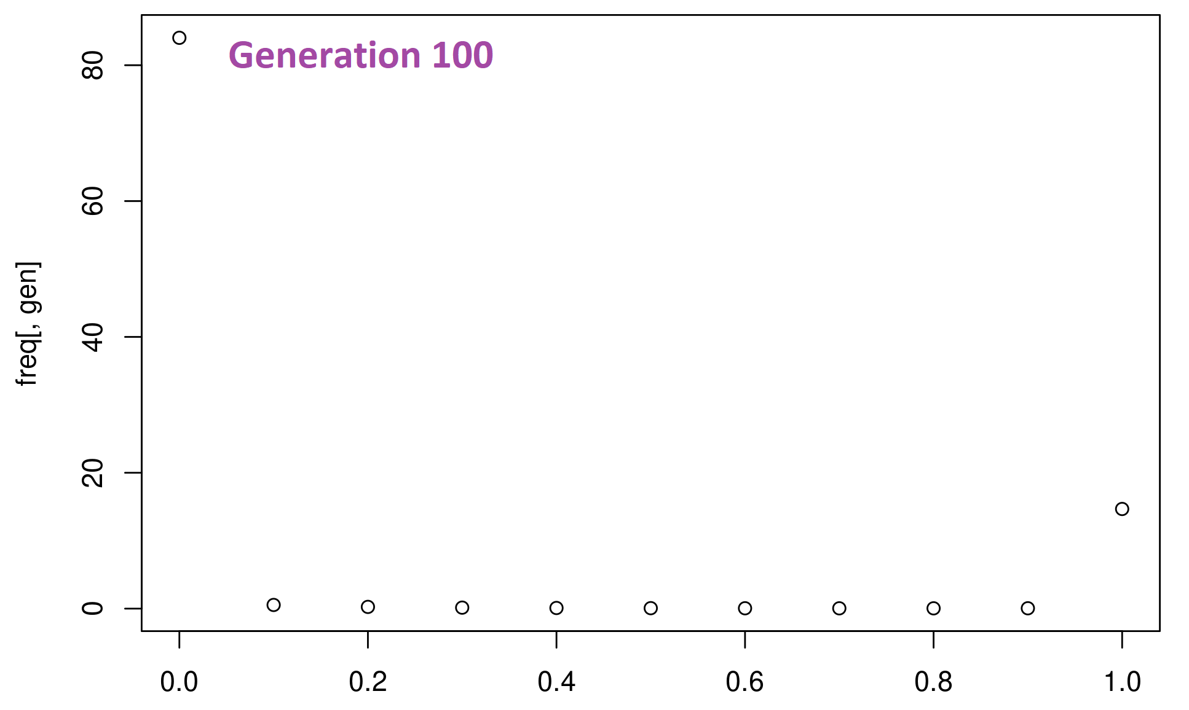
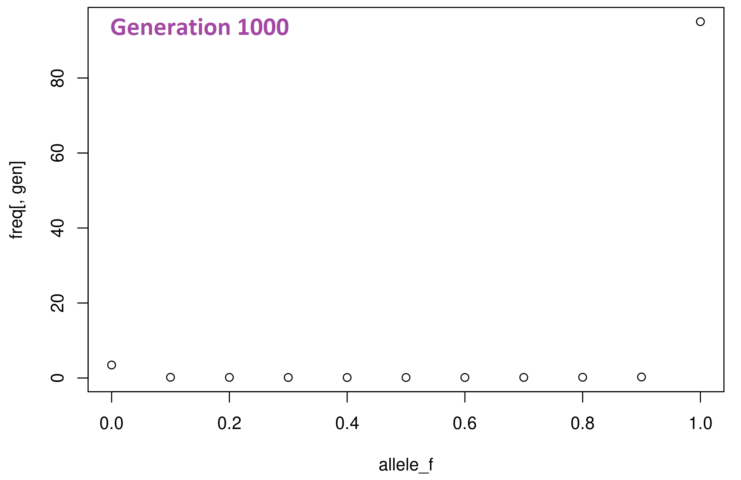
Cooperators are lost in ‘almost all’ groups, but ‘not all’ groups

Slide 7
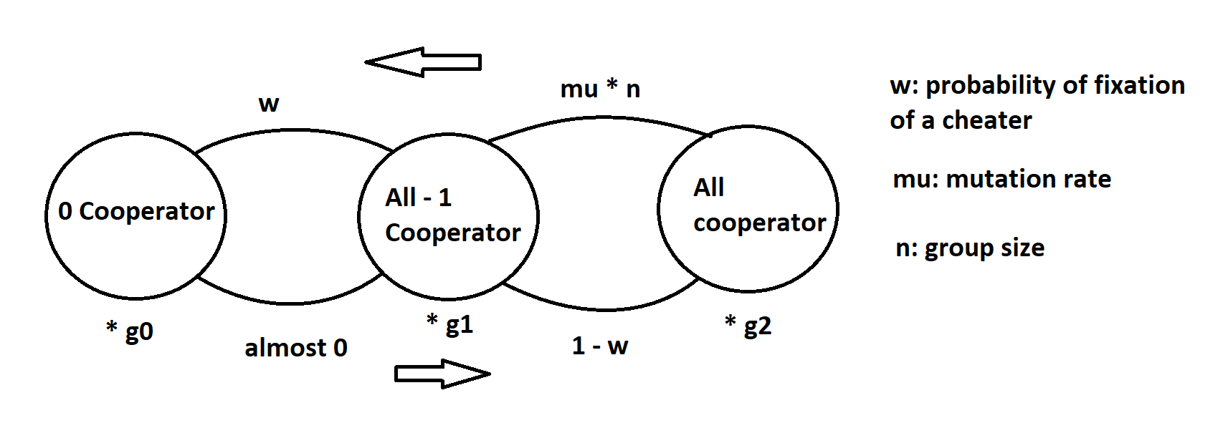
Simplifying the model into 3 states
Caution: I haven’t checked yet that under what circumstances it’s a good approximation of the model,
because I’m lazy! But I must do it!

Slide 8
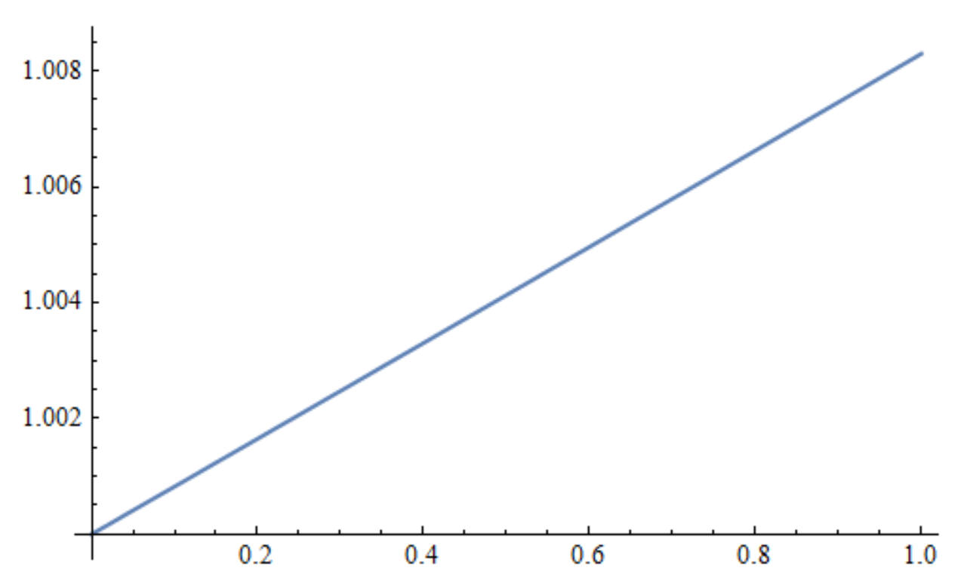
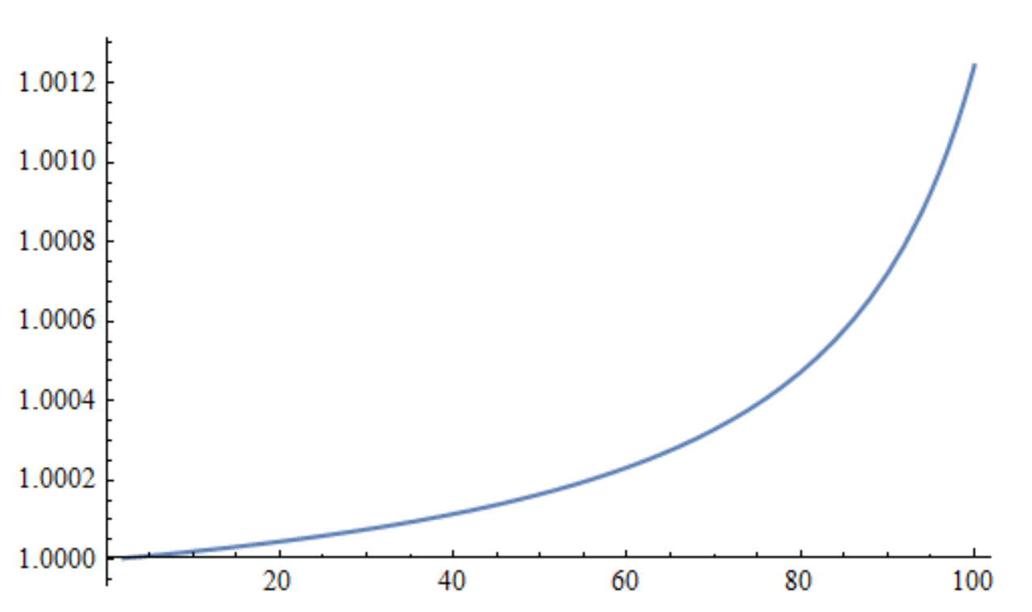
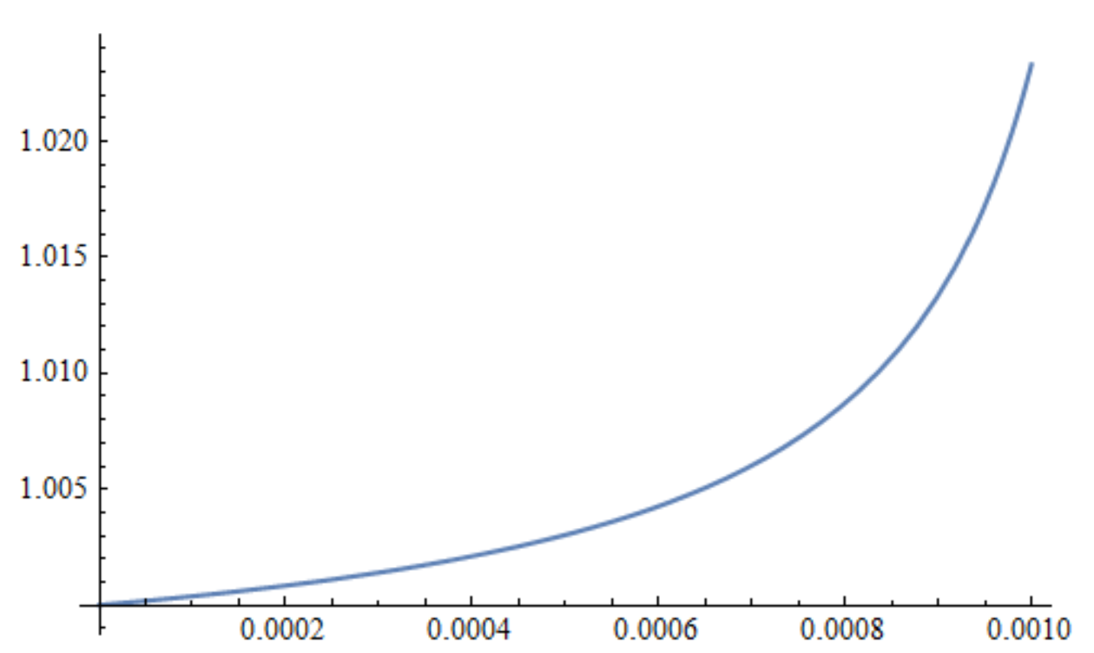
How beneficial a traits should be for the group so that cooperators can persist?
Probability of fixation of cheaters
Mutation rate
Group size
Limitation: It’s assumed that probability of fixation of a cheater and also the time that it takes for a cheater to go
to fixation is independent of group size, which is wrong. I could have corrected it but I was lazy. I’ll do it soon and
let you know if the results are qualitatively similar

Slide 9
What would be the upper-limit of how cooperative individuals become?
Possible reasons:
Cost of cooperation becomes higher and higher as individuals become more cooperative (because of limited resources for growing)
Increase in mutation rate when there are multiple loci involved
3) Limited opportunities for cooperation

Slide 10
summarizing interesting results of the model
1- group size matters => cell size and diffusion rate matters (In producer – non-producer game. It might be a bit different in other scenarios)
2- If a trait is good enough, the cost is not important
3- Number of loci underlying the cooperation is very important, specifically when group size is large

Slide 11
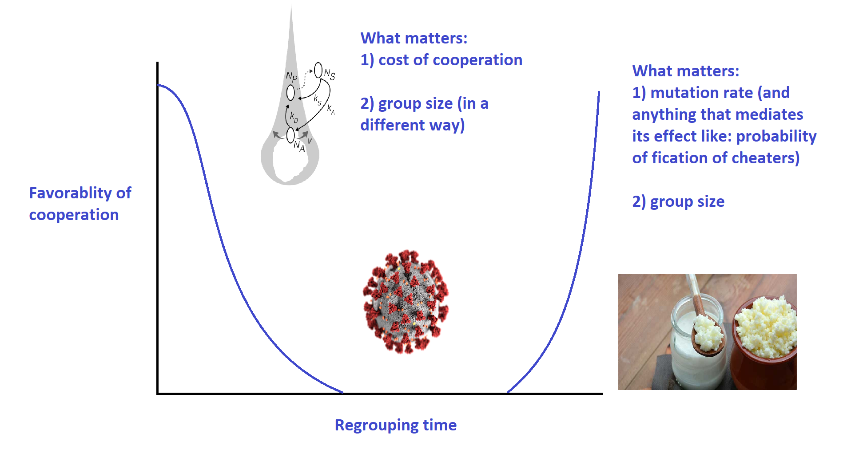
Two solutions for persistence of cooperators

Slide 12
My questions
1- What does the evolution of cooperation mean when it comes to the interaction of multiple species
2- How does division of labor emerge?

Slide 13
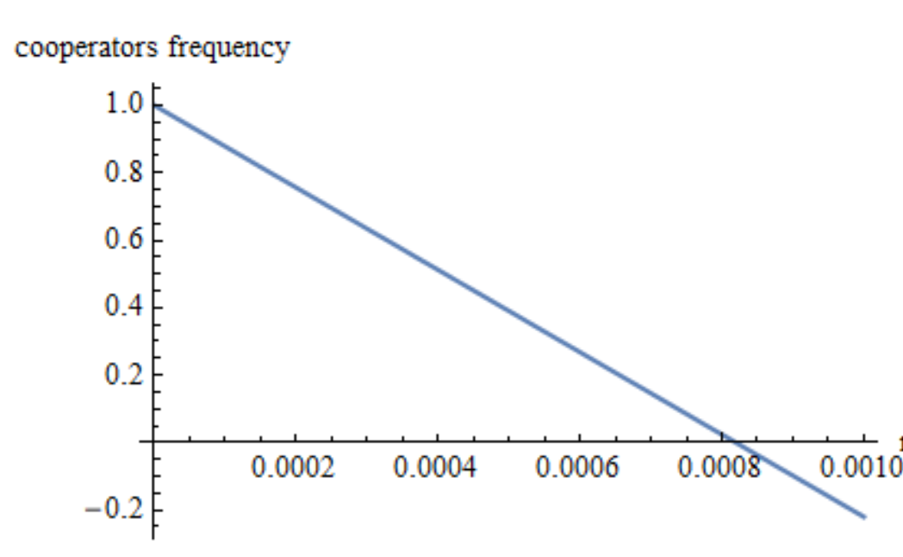
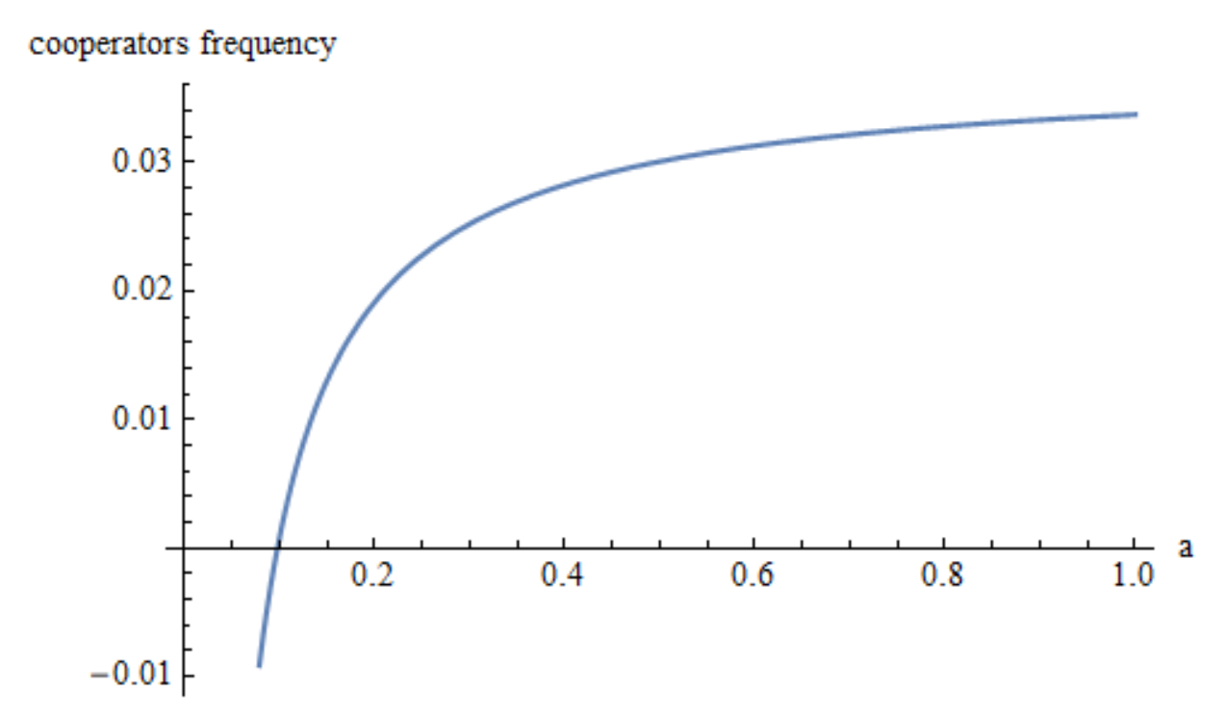
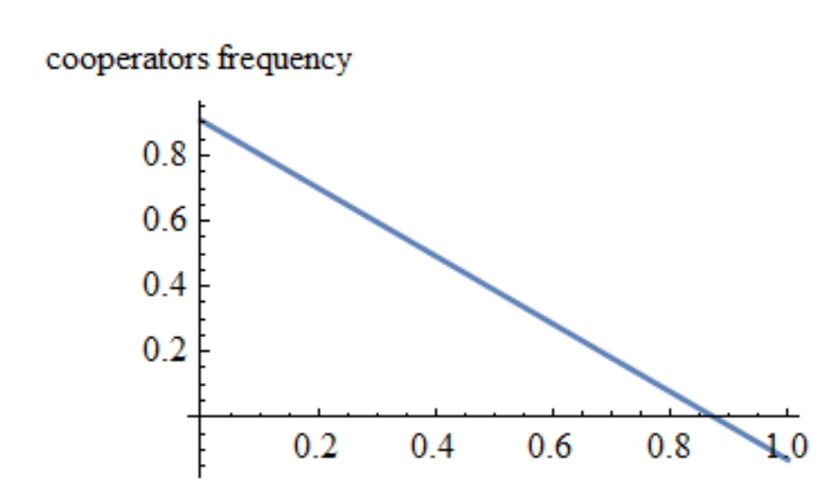
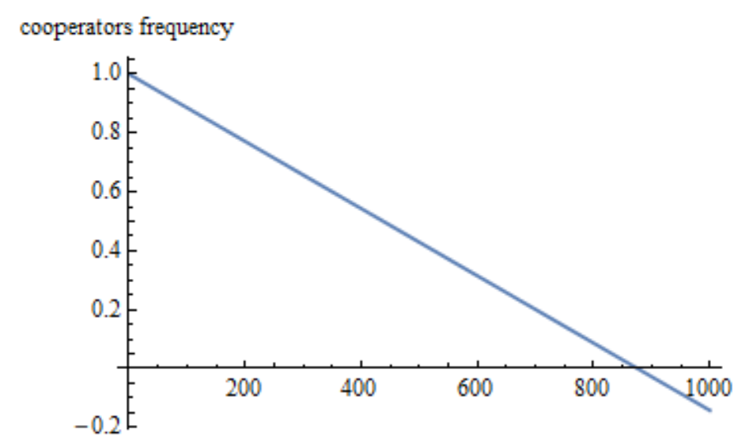
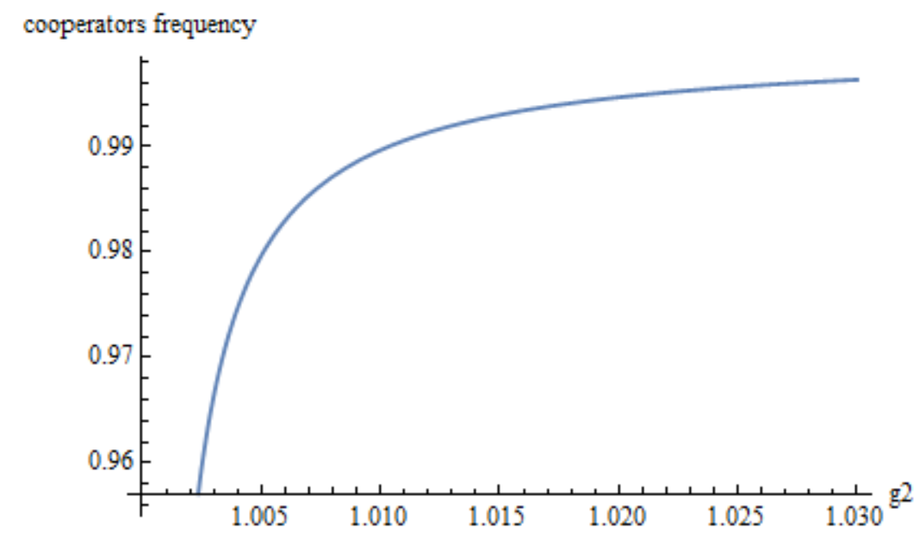
How frequency of cooperators is affected by different factors?
Mutation rate
How fast cheaters go to fixation
Probability of
fixation of a cheater
How good the fully
cooperative groups are
Group size

